Slide 1
Data Mining Classification: Alternative Techniques
Lecture Notes for Chapter 5
Introduction to Data Mining
by
Tan, Steinbach, Kumar
© Tan,Steinbach, Kumar Introduction to Data Mining 4/18/2004 1

Slide 2
Rule-based Classifier (Example)
R1: (Give Birth = no) ∧ (Can Fly = yes) → Birds
R2: (Give Birth = no) ∧ (Live in Water = yes) → Fishes
R3: (Give Birth = yes) ∧ (Blood Type = warm) → Mammals
R4: (Give Birth = no) ∧ (Can Fly = no) → Reptiles
R5: (Live in Water = sometimes) → Amphibians

Slide 3
Rule-Based Classifier
Classify records by using a collection of “if…then…” rules
Rule: (Condition) → y
where
Condition is a conjunctions of attributes
y is the class label
LHS: rule antecedent or condition
RHS: rule consequent
Examples of classification rules:
(Blood Type=Warm) ∧ (Lay Eggs=Yes) → Birds
(Taxable Income < 50K) ∧ (Refund=Yes) → Evade=No

Slide 4
Application of Rule-Based Classifier
A rule r covers an instance x if the attributes of the instance satisfy the condition of the rule
R1: (Give Birth = no) ∧ (Can Fly = yes) → Birds
R2: (Give Birth = no) ∧ (Live in Water = yes) → Fishes
R3: (Give Birth = yes) ∧ (Blood Type = warm) → Mammals
R4: (Give Birth = no) ∧ (Can Fly = no) → Reptiles
R5: (Live in Water = sometimes) → Amphibians
The rule R1 covers a hawk => Bird
The rule R3 covers the grizzly bear => Mammal

Slide 5
Rule Coverage and Accuracy
Coverage of a rule:
Fraction of records that satisfy the antecedent of a rule
Accuracy of a rule:
Fraction of records that satisfy both the antecedent and consequent of a rule
(Status=Single) → No
Coverage = 40%, Accuracy = 50%

Slide 6
How does Rule-based Classifier Work?
R1: (Give Birth = no) ∧ (Can Fly = yes) → Birds
R2: (Give Birth = no) ∧ (Live in Water = yes) → Fishes
R3: (Give Birth = yes) ∧ (Blood Type = warm) → Mammals
R4: (Give Birth = no) ∧ (Can Fly = no) → Reptiles
R5: (Live in Water = sometimes) → Amphibians
A lemur triggers rule R3, so it is classified as a mammal
A turtle triggers both R4 and R5
A dogfish shark triggers none of the rules

Slide 7
Characteristics of Rule-Based Classifier
Mutually exclusive rules
Classifier contains mutually exclusive rules if the rules are independent of each other
Every record is covered by at most one rule
Exhaustive rules
Classifier has exhaustive coverage if it accounts for every possible combination of attribute values
Each record is covered by at least one rule

Slide 8
From Decision Trees To Rules
Rules are mutually exclusive and exhaustive
Rule set contains as much information as the tree

Slide 9
Rules Can Be Simplified
Initial Rule: (Refund=No) ∧ (Status=Married) → No
Simplified Rule: (Status=Married) → No

Slide 10
Problems with Rule Simplification
Rules are no longer mutually exclusive
A record may trigger more than one rule
Solution?
Ordered rule set
Unordered rule set – use voting schemes
Rules are no longer exhaustive
A record may not trigger any rules
Solution?
Use a default class

Slide 11
Ordered Rule Set
Rules are rank ordered according to their priority
An ordered rule set is known as a decision list
When a test record is presented to the classifier
It is assigned to the class label of the highest ranked rule it has triggered
If none of the rules fired, it is assigned to the default class
R1: (Give Birth = no) ∧ (Can Fly = yes) → Birds
R2: (Give Birth = no) ∧ (Live in Water = yes) → Fishes
R3: (Give Birth = yes) ∧ (Blood Type = warm) → Mammals
R4: (Give Birth = no) ∧ (Can Fly = no) → Reptiles
R5: (Live in Water = sometimes) → Amphibians

Slide 12
Rule Ordering Schemes
Rule-based ordering
Individual rules are ranked based on their quality
Class-based ordering
Rules that belong to the same class appear together
Accuracy: 1
Accuracy: 1
Accuracy: .8
Accuracy: .7

Slide 13
Building Classification Rules
Direct Method:
Extract rules directly from data
e.g.: RIPPER, CN2, Holte’s 1R
Indirect Method:
Extract rules from other classification models (e.g. decision trees, neural networks, etc).
e.g: C4.5rules

Slide 14
Direct Method: Sequential Covering
Start from an empty rule
Grow a rule using the Learn-One-Rule function
Remove training records covered by the rule
Repeat Step (2) and (3) until stopping criterion is met

Slide 15
Example of Sequential Covering

Slide 16
Example of Sequential Covering…

Slide 17
Example of Sequential Covering…
Finally, add default rule.
R3

Slide 18
Aspects of Sequential Covering
Instance Elimination
Rule Growing
Rule Evaluation
Stopping Criterion
Rule Pruning

Slide 19
Instance Elimination
Why do we need to eliminate instances?
Otherwise, the next rule is identical to previous rule
Why do we remove positive instances?
Ensure that the next rule is different
Why do we remove negative instances?
Prevent underestimating accuracy of rule
Compare rules R2 and R3 in the diagram

Slide 20
Rule Growing
Two common strategies

Slide 21
Rule Evaluation
Metrics:
Accuracy
Laplace
M-estimate
n : Number of instances covered by rule
n_{c} : Number of correct (positive) instances covered by rule
k : Number of classes
p : Prior probability

Slide 22
Stopping Criterion and Rule Pruning
Stopping criterion
Compute the gain
If gain is not significant, discard the new rule
Rule Pruning
Similar to post-pruning of decision trees
Reduced Error Pruning:
Remove one of the conjuncts in the rule
Compare error rate on validation set before and after pruning
If error improves, prune the conjunct

Slide 23
Summary of Direct Method
Grow a single rule
Remove Instances from rule
Prune the rule (if necessary)
Add rule to Current Rule Set
Repeat

Slide 24
Direct Method: RIPPER
For 2-class problem, choose one of the classes as positive class, and the other as negative class
Learn rules for positive class
Negative class will be default class
For multi-class problem
Order the classes according to increasing class prevalence (fraction of instances that belong to a particular class)
Learn the rule set for smallest class first, treat the rest as negative class
Repeat with next smallest class as positive class

Slide 25
Rule Growing (Examples)
RIPPER Algorithm:
Start from an empty rule: {} => class
Add conjuncts that maximizes FOIL’s information gain measure:
R0: {} => class (initial rule)
R1: {A} => class (rule after adding conjunct)
Gain(R0, R1) = t [ log (p1/(p1+n1)) – log (p0/(p0 + n0)) ]
where t: number of positive instances covered by both R0 and R1
p0: number of positive instances covered by R0
n0: number of negative instances covered by R0
p1: number of positive instances covered by R1
n1: number of negative instances covered by R1

Slide 26
Direct Method: RIPPER
Growing a rule:
Start from empty rule
Add conjuncts as long as they improve FOIL’s information gain
Stop when rule starts covering negative examples
Prune the rule immediately using incremental reduced error pruning
Measure for pruning: v = (p-n)/(p+n)
p: number of positive examples covered by the rule in the validation set
n: number of negative examples covered by the rule in the validation set
Pruning method: delete any final sequence of conditions that maximizes v

Slide 27
Direct Method: RIPPER
Building a Rule Set:
Use sequential covering algorithm
Finds the best rule that covers the current set of positive examples
Eliminate both positive and negative examples covered by the rule
Each time a rule is added to the rule set, compute the new description length
stop adding new rules when the new description length is d bits longer than the smallest description length obtained so far

Slide 28
Direct Method: RIPPER
Optimize the rule set:
For each rule r in the rule set R
Consider 2 alternative rules:
Replacement rule (r*): grow new rule from scratch
Revised rule(r’): add conjuncts to extend the rule r
Compare the rule set for r against the rule set for r* and r’
Choose rule set that minimizes MDL principle
Repeat rule generation and rule optimization for the remaining positive examples

Slide 29
Indirect Methods

Slide 30
Indirect Method: C4.5rules
Extract rules from an unpruned decision tree
For each rule, r: A → y,
consider an alternative rule r’: A’ → y where A’ is obtained by removing one of the conjuncts in A
Compare the pessimistic error rate for r against all r’s
Prune if one of the r’s has lower pessimistic error rate
Repeat until we can no longer improve generalization error

Slide 31
Indirect Method: C4.5rules
Instead of ordering the rules, order subsets of rules (class ordering)
Each subset is a collection of rules with the same rule consequent (class)
Compute description length of each subset
Description length = L(error) + g L(model)
g is a parameter that takes into account the presence of redundant attributes in a rule set (default value = 0.5)

Slide 32
Example

Slide 33
C4.5 versus C4.5rules versus RIPPER
C4.5rules:
(Give Birth=No, Can Fly=Yes) → Birds
(Give Birth=No, Live in Water=Yes) → Fishes
(Give Birth=Yes) → Mammals
(Give Birth=No, Can Fly=No, Live in Water=No) → Reptiles
( ) → Amphibians
RIPPER:
(Live in Water=Yes) → Fishes
(Have Legs=No) → Reptiles
(Give Birth=No, Can Fly=No, Live In Water=No) → Reptiles
(Can Fly=Yes,Give Birth=No) → Birds
() → Mammals

Slide 34
C4.5 versus C4.5rules versus RIPPER
C4.5 and C4.5rules:
RIPPER:

Slide 35
Advantages of Rule-Based Classifiers
As highly expressive as decision trees
Easy to interpret
Easy to generate
Can classify new instances rapidly
Performance comparable to decision trees

Slide 36
Instance-Based Classifiers
Store the training records
Use training records to predict the class label of unseen cases

Slide 37
Instance Based Classifiers
Examples:
Rote-learner
Memorizes entire training data and performs classification only if attributes of record match one of the training examples exactly
Nearest neighbor
Uses k “closest” points (nearest neighbors) for performing classification

Slide 38
Nearest Neighbor Classifiers
Basic idea:
If it walks like a duck, quacks like a duck, then it’s probably a duck
Compute Distance
Test Record
Training Records
Choose k of the “nearest” records

Slide 39
Nearest-Neighbor Classifiers
Requires three things
The set of stored records
Distance Metric to compute distance between records
The value of k, the number of nearest neighbors to retrieve
To classify an unknown record:
Compute distance to other training records
Identify k nearest neighbors
Use class labels of nearest neighbors to determine the class label of unknown record (e.g., by taking majority vote)

Slide 40
Definition of Nearest Neighbor
K-nearest neighbors of a record x are data points that have the k smallest distance to x

Slide 41
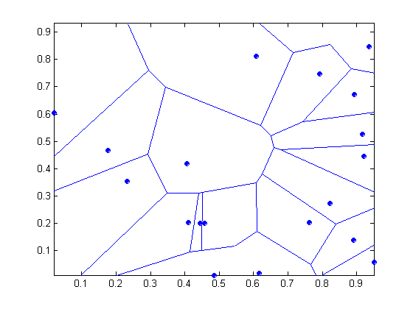
Decision Boundary: 1 Nearest-Neighbor
Voronoi Diagram

Slide 42
Nearest Neighbor Classification
Compute distance between two points:
Euclidean distance
Determine the class from nearest neighbor list
take the majority vote of class labels among the k-nearest neighbors
Weigh the vote according to distance
weight factor, w = 1/d²

Slide 43
Nearest Neighbor Classification…
Problem with Euclidean measure:
High dimensional data
curse of dimensionality
Can produce counter-intuitive results
1 1 1 1 1 1 1 1 1 1 1 0
1 0 0 0 0 0 0 0 0 0 0 0
vs
0 1 1 1 1 1 1 1 1 1 1 1
0 0 0 0 0 0 0 0 0 0 0 1
d = 1.4142
d = 1.4142
Solution: Normalize the vectors to unit length

Slide 44
Nearest Neighbor Classification…
Scaling issues
Attributes may have to be scaled to prevent distance measures from being dominated by one of the attributes
Example:
height of a person may vary from 1.5m to 1.8m
weight of a person may vary from 90lb to 300lb
income of a person may vary from $10K to $1M

Slide 45
Nearest Neighbor Classification…
Choosing the value of k:
If k is too small, sensitive to noise points
If k is too large, neighborhood may include points from other classes

Slide 46
Nearest neighbor Classification…
k-NN classifiers are lazy learners
It does not build models explicitly
Unlike eager learners such as decision tree induction and rule-based systems
Classifying unknown records are relatively expensive

Slide 47
Example: PEBLS
PEBLS: Parallel Examplar-Based Learning System (Cost & Salzberg)
Works with both continuous and nominal features
For nominal features, distance between two nominal values is computed using modified value difference metric (MVDM)
Each record is assigned a weight factor
Number of nearest neighbor, k = 1

Slide 48
Example: PEBLS
Distance between nominal attribute values:
d(Single,Married)
= | 2/4 – 0/4 | + | 2/4 – 4/4 | = 1
d(Single,Divorced)
= | 2/4 – 1/2 | + | 2/4 – 1/2 | = 0
d(Married,Divorced)
= | 0/4 – 1/2 | + | 4/4 – 1/2 | = 1
d(Refund=Yes,Refund=No)
= | 0/3 – 3/7 | + | 3/3 – 4/7 | = 6/7
Class | Marital Status
 | Single | Married | Divorced
Yes | 2 | 0 | 1
No | 2 | 4 | 1
Class | Refund
 | Yes | No
Yes | 0 | 3
No | 3 | 4

Slide 49
Example: PEBLS
Distance between record X and record Y:
where:
w_{X} ≅ 1 if X makes accurate prediction most of the time
w_{X} > 1 if X is not reliable for making predictions

Slide 50
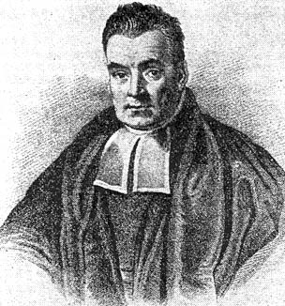
The Good Reverend Bayes

Slide 51
Bayes Classifier
A probabilistic framework for solving classification problems
Conditional Probability:
Bayes theorem:

Slide 52
Example of Bayes Theorem
Given:
Meningitis causes stiff neck 50% of the time
Prior probability of any patient having meningitis is 1/50,000
Prior probability of any patient having stiff neck is 1/20
If a patient has stiff neck, what’s the probability he/she has meningitis?

Slide 53
Example of Bayes Theorem (con’td)
Given:
Flue causes stiff neck 40% of the time
Prior probability of any patient having flue is 1/20,000
Prior probability of any patient having stiff neck is 1/20
If a patient has stiff neck, what’s the probability he/she has flue?

Slide 54
Example of Bayes Theorem (con’td)
Choose class/hypothesis with largest posterior probability
Posterior probability of flue given a stiff neck: P(F|S) = 0.004
Posterior probability of menengitis given a stiff neck: P(M|S) = 0.0002

Slide 55
Bayesian Classifiers
Now in general: Given a training data set. Consider each attribute and class label as random variables.
Given a record with attributes (A₁, A₂,…,A_{n})
Goal is to predict class C
Specifically, we want to find the value of C that maximizes P(C| A₁, A₂,…,A_{n} )
Can we estimate P(C| A₁, A₂,…,A_{n} ) directly from data?

Slide 56
Bayesian Classifiers
Approach:
compute the posterior probability P(C | A₁, A₂, …, A_{n}) for all values of C using the Bayes theorem
Choose value of C that maximizes P(C | A₁, A₂, …, A_{n})
Equivalent to choosing value of C that maximizes P(A₁, A₂, …, A_{n}|C) P(C)
How to estimate P(A₁, A₂, …, A_{n} | C )?

Slide 57
Naïve Bayes Classifier
Assume independence among attributes A_{i} when class is given:
P(A₁, A₂, …, A_{n} |C) = P(A₁| C_{j}) P(A₂| C_{j})… P(A_{n}| C_{j})
Can estimate P(A_{i}| C_{j}) for all A_{i} and C_{j}.
New point is classified to C_{j} if P(C_{j}) Π P(A_{i}| C_{j}) is maximal.

Slide 58
How to Estimate Probabilities from Data?
Class: P(C) = N_{c}/N
e.g., P(No) = 7/10, P(Yes) = 3/10
For discrete attributes: P(A_{i} | C_{k}) = |A_{ik}|/ N_{c}
where |A_{ik}| is number of instances having attribute A_{i} and belong to class C_{k}
Examples:
P(Status=Married|No) = 4/7 P(Refund=Yes|Yes)=0
k

Slide 59
Example of Naïve Bayes Classifier
A: attributes
M: mammals
N: non-mammals
P(A|M)P(M) > P(A|N)P(N)
=> Mammals

Slide 60
How to Estimate Probabilities from Data?
For continuous attributes:
Discretize the range into bins
one ordinal attribute per bin
Probability density estimation:
Assume attribute follows a normal distribution
Use data to estimate parameters of distribution (e.g., mean and standard deviation)
Once probability distribution is known, can use it to estimate the conditional probability P(A_{i}|c)

Slide 61
How to Estimate Probabilities from Data?
Normal distribution:
One for each (A_{i},c_{i}) pair
For (Income, Class=No):
If Class=No
sample mean = 110
sample variance = 2975

Slide 62
Example of a Naïve Bayes Classification
Given a Test Record:
P(X|Class=No) = P(Refund=No|Class=No) × P(Married| Class=No) × P(Income=120K| Class=No) = 4/7 × 4/7 × 0.0072 = 0.0024
P(X|Class=Yes) = P(Refund=No| Class=Yes) × P(Married| Class=Yes) × P(Income=120K| Class=Yes) = 1 × 0 × 1.2 × 10⁻⁹ = 0
Since P(X|No)P(No) > P(X|Yes)P(Yes)
Therefore P(No|X) > P(Yes|X) => Class = No

Slide 63
Naïve Bayes Classifier
If one of the conditional probability is zero, then the entire expression becomes zero
Probability estimation:
c: number of classes
p: prior probability
m: parameter

Slide 64
Naïve Bayes (Summary)
Robust to isolated noise points
Handle missing values by ignoring the instance during probability estimate calculations
Robust to irrelevant attributes
Independence assumption may not hold for some attributes
Use other techniques such as Bayesian Belief Networks (BBN)

Slide 65
Artificial Neural Networks (ANN)
Output Y is 1 if at least two of the three inputs are equal to 1.

Slide 66
Artificial Neural Networks (ANN)

Slide 67
Artificial Neural Networks (ANN)
Model is an assembly of inter-connected nodes and weighted links
Output node sums up each of its input value according to the weights of its links
Compare output node against some threshold t
Perceptron Model
or

Slide 68
General Structure of ANN
Training ANN means learning the weights of the neurons

Slide 69
Algorithm for learning ANN
Initialize the weights (w₀, w₁, …, w_{k})
Adjust the weights in such a way that the output of ANN is consistent with class labels of training examples
Objective function:
Find the weights w_{i}’s that minimize the above objective function
e.g., backpropagation algorithm

Slide 70
Advantages
High prediction accuracy possible
With choice of suitable network topology
With choice of suitable learning method
Robust with respect to noise in training data
Discrete, continuous, or vector outputs
Fast classification once trained

Slide 71
Disadvantages
Long training time for each specific network
Empirical search for suitable networks
Overfitting still a possibility
No explicit knowledge
Incorporating domain knowledge is awkward

Slide 72
Support Vector Machines
Find a linear hyperplane (decision boundary) that will separate the data

Slide 73
Support Vector Machines
One Possible Solution

Slide 74
Support Vector Machines
Another possible solution

Slide 75
Support Vector Machines
Other possible solutions

Slide 76
Support Vector Machines
Which one is better? B1 or B2?
How do you define better?

Slide 77
Support Vector Machines
Find hyperplane maximizes the margin => B1 is better than B2

Slide 78
Support Vector Machines

Slide 79
Support Vector Machines
We want to maximize:
Which is equivalent to minimizing:
But subjected to the following constraints:
This is a constrained optimization problem
Numerical approaches to solve it (e.g., quadratic programming)

Slide 80
Support Vector Machines
What if the problem is not linearly separable?

Slide 81
Support Vector Machines
What if the problem is not linearly separable?
Introduce slack variables
Need to minimize:
Subject to:

Slide 82
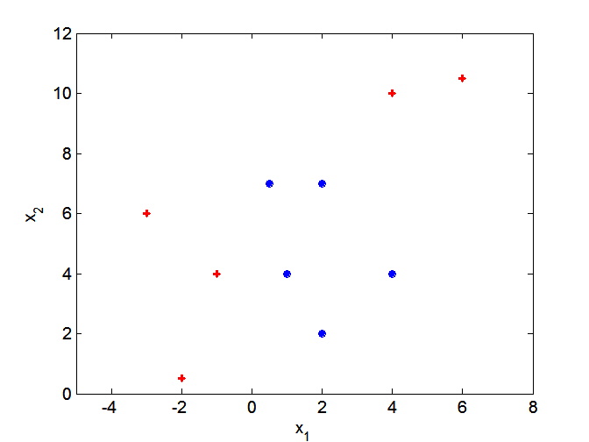
Nonlinear Support Vector Machines
What if decision boundary is not linear?

Slide 83
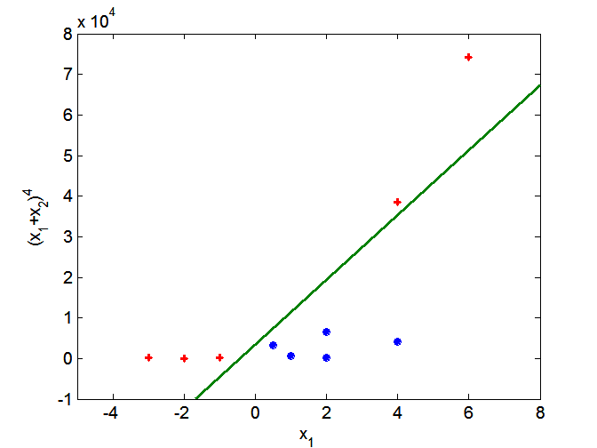
Nonlinear Support Vector Machines
Transform data into higher dimensional space

Slide 84
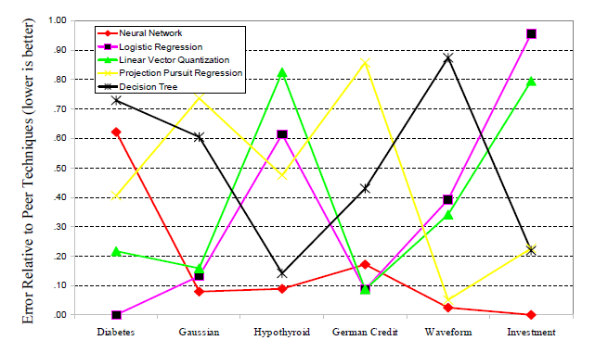
Performance of Individual Methods

Slide 85
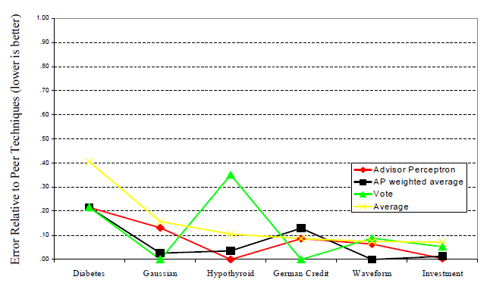
Performance of Ensemble
A camel is a horse designed by a committee?

Slide 86
Ensemble Methods
Construct a set of classifiers from the training data
Predict class label of previously unseen records by aggregating predictions made by multiple classifiers

Slide 87
General Idea

Slide 88
Why does it work?
Suppose there are 25 base classifiers
Each classifier has error rate, ε = 0.35
Assume classifiers are independent
Probability that the ensemble classifier makes a wrong prediction:

Slide 89
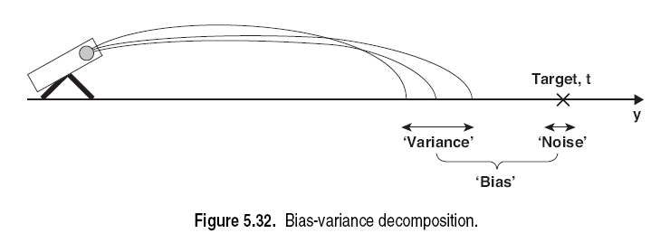
Bias – Variance Tradeoff

Slide 90
Examples of Ensemble Methods
How to generate an ensemble of classifiers?
Bagging
Boosting

Slide 91
Bagging
Sampling with replacement
Build classifier on each bootstrap sample
Each sample has probability (1 – 1/n)^{n} of being selected

Slide 92

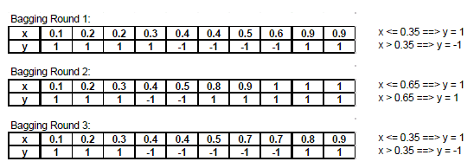
Bagging, continued
Original data (x) and labels (y)
Bootstrap samples

Slide 93
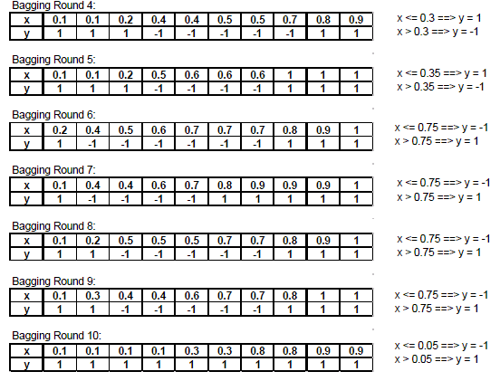
Bagging, continued

Slide 94
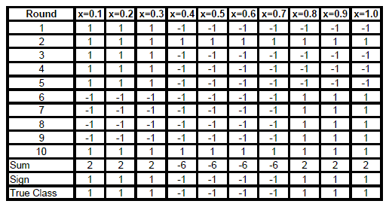
Bagging, results

Slide 95
Boosting
An iterative procedure to adaptively change distribution of training data by focusing more on previously misclassified records
Initially, all N records are assigned equal weights
Unlike bagging, weights may change at the end of boosting round

Slide 96

Adaboost - Adaptive Boosting
Instead of resampling, uses training set re-weighting
Each training sample uses a weight to determine the probability of being selected for a training set.
AdaBoost is an algorithm for constructing a strong classifier as linear combination of weak classifier
h_{t}(x) … “weak” or basis classifier, < 50% error over any distribution
Final classification based on weighted vote of weak classifiers

Slide 97
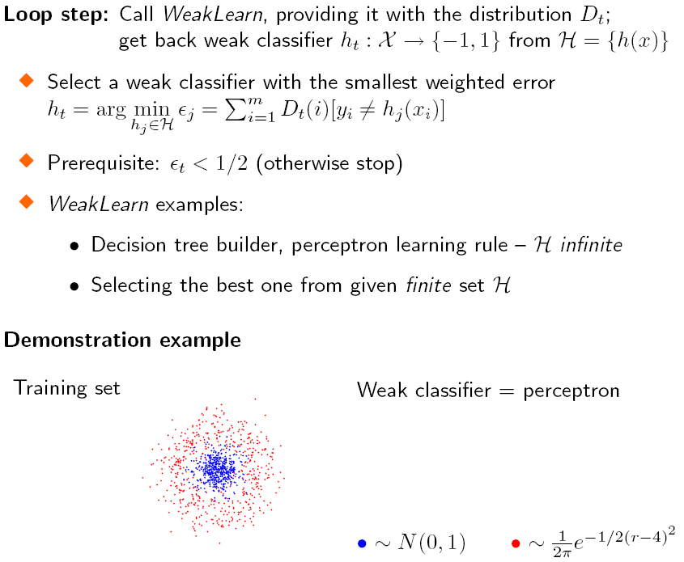
Find the Weak Classifier
Notes:
The error is determined with respect to the distribution D

Slide 98
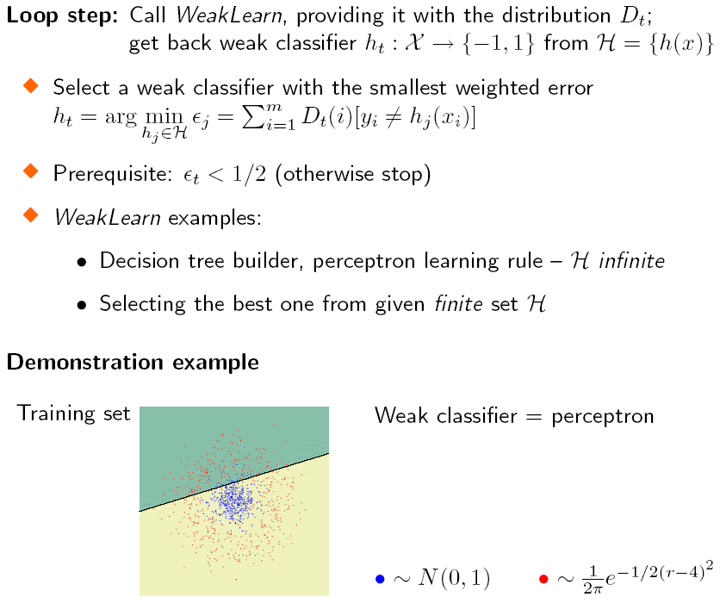
Find the Weak Classifier

Slide 99
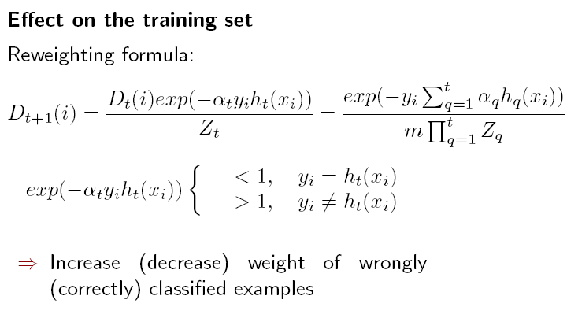
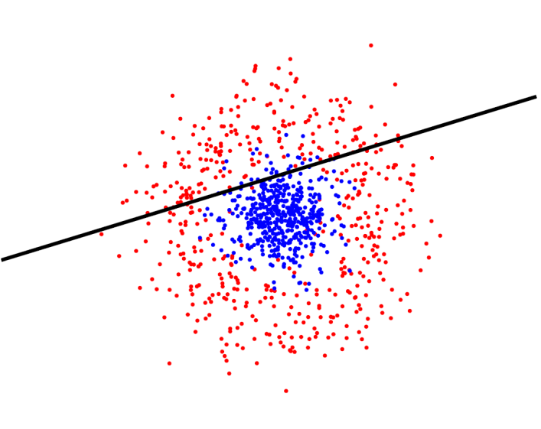
Reweighting
y * h(x) = 1
y * h(x) = -1

Slide 100
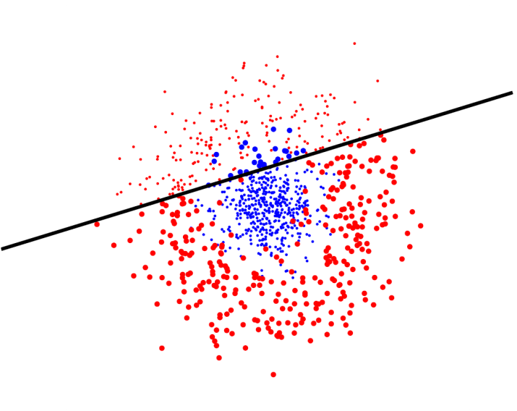
Reweighting
In this way, AdaBoost “focused on” the informative or “difficult” examples.

Slide 101
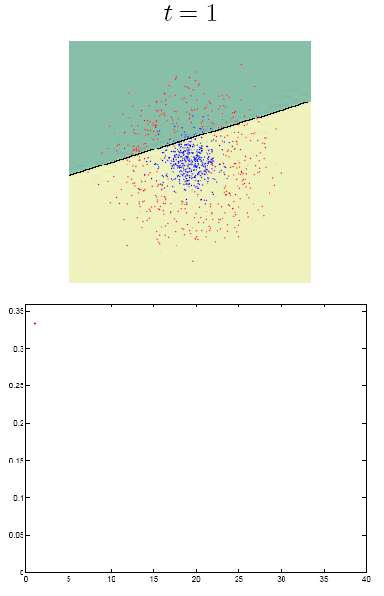
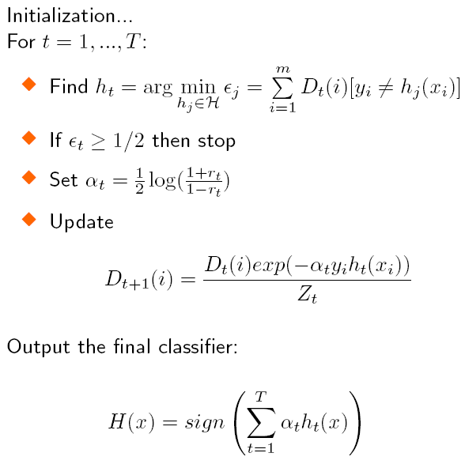
Algorithm recapitulation

Slide 102
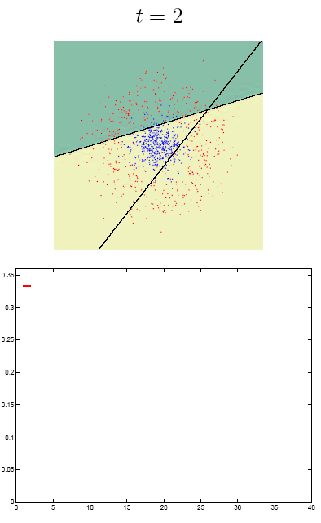
Algorithm recapitulation

Slide 103
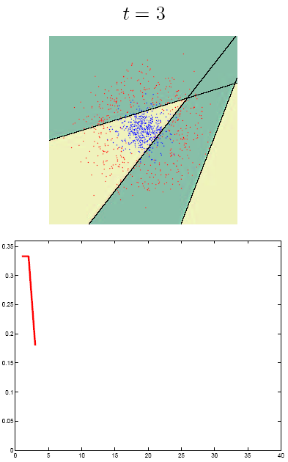
Algorithm recapitulation

Slide 104
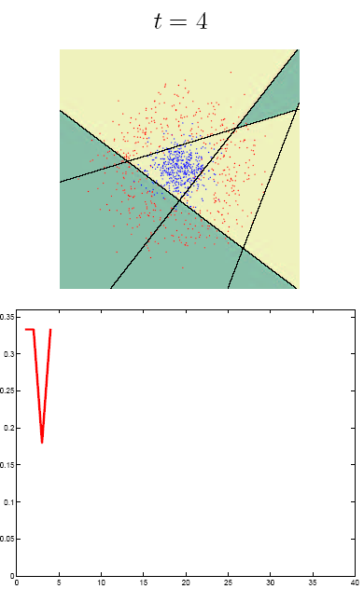
Algorithm recapitulation

Slide 105
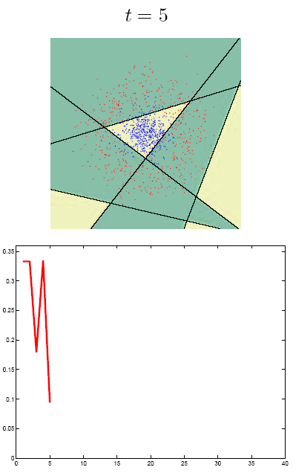
Algorithm recapitulation

Slide 106
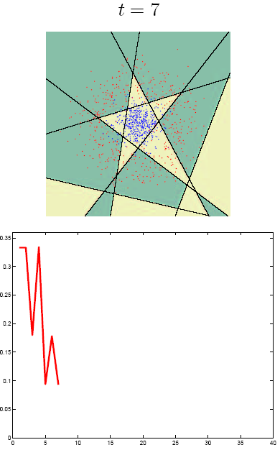
Algorithm recapitulation

Slide 107
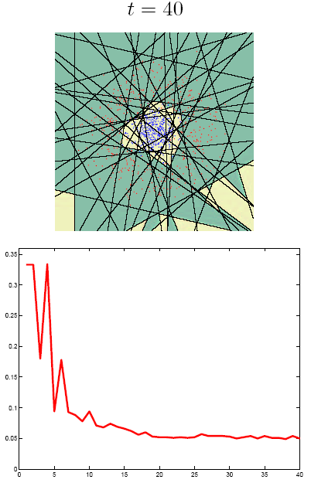
Algorithm recapitulation

Slide 108
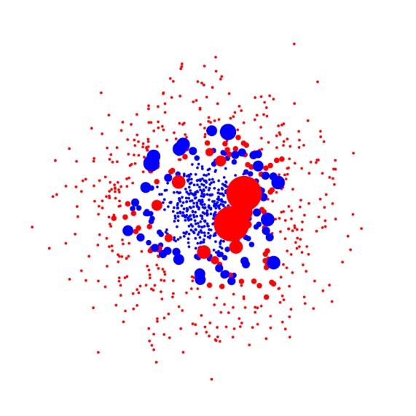
Reweighting
In this way, AdaBoost “focused on” the informative or “difficult” examples.

Slide 109
Pros and cons of AdaBoost
Advantages
Simple to implement
Results in simple classifier
Resistant against overfitting
Fairly good generalization
Disadvantages
Suboptimal solution
Sensitive to noisy data and outliers
Notes:
Sensitive to noisy data and outliers
Be wary if using noisy/unlabeled data

Slide 110
Illustrating AdaBoost
Initial weights for each data point
Data points for training

Slide 111
Illustrating AdaBoost

Slide 112

Thank You!

